Slide 1
Symptom based disease prediction using ML algorithms
Jaini Lakshmi Sabari Priya-16BIT0189

Slide 2
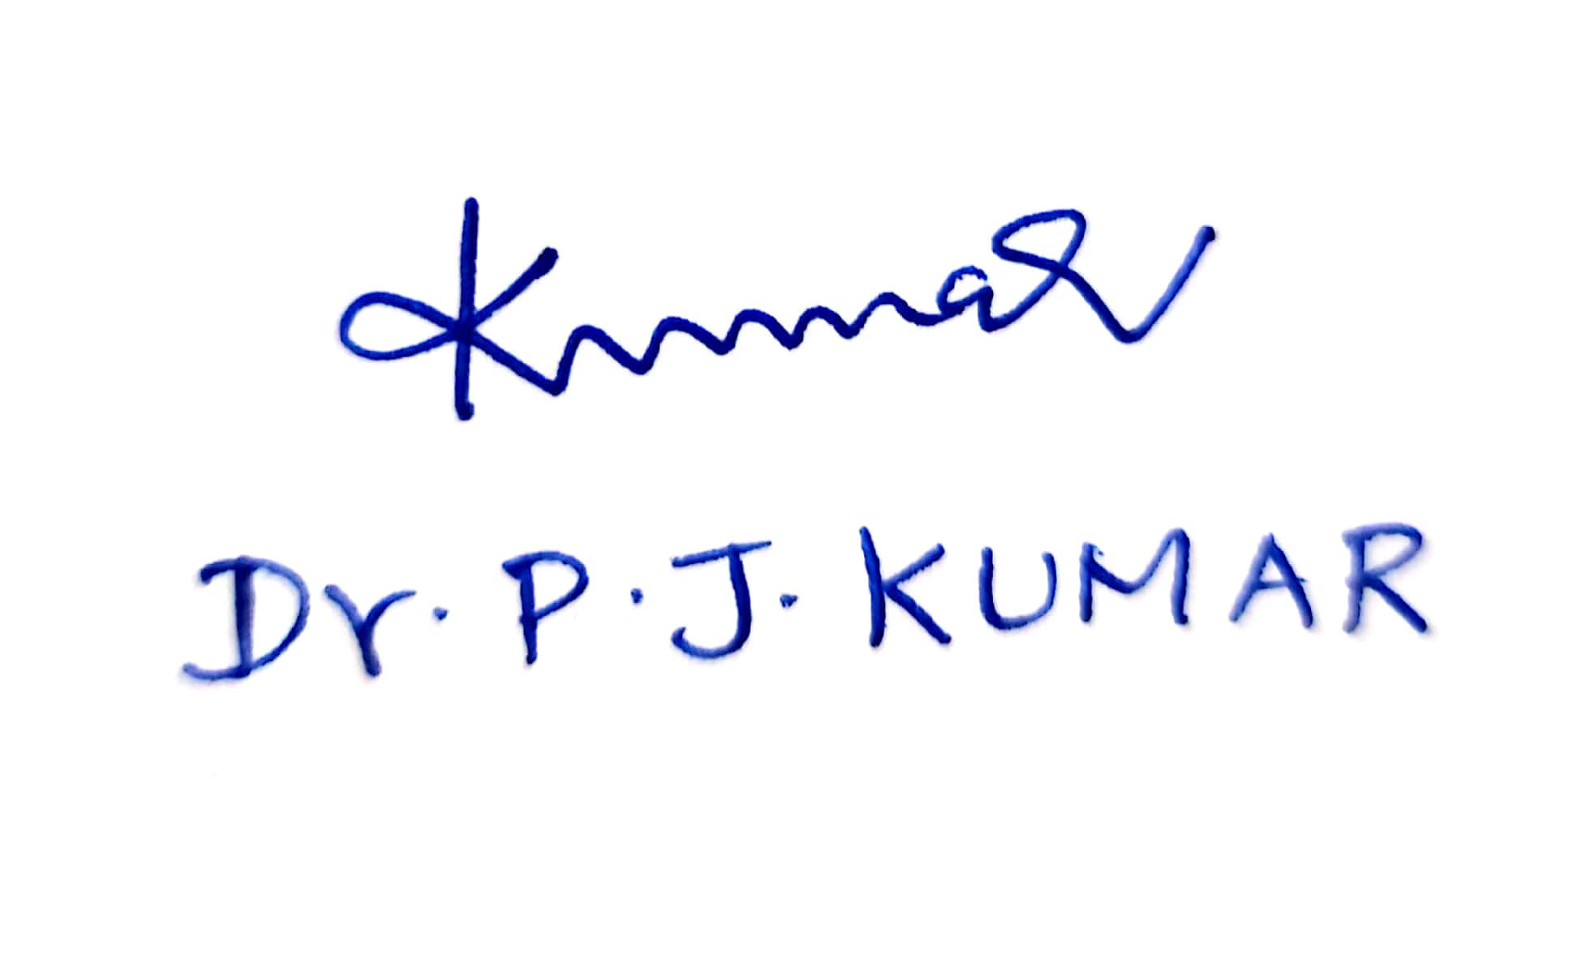
Signature of the guide

Slide 3
Project overview
Machine learning has a major impact on healthcare analytics and it have the capacity to reduce costs of treatment, predict outbreaks of epidemics, avoid preventable diseases and improve the quality of life. Accurate analysis of medical data benefits in early disease detection and well patient care in big data. In this project, machine learning algorithms are used for effective prediction of diseases . Now-a-days, individuals face different infections due to the natural condition and their living propensities. So the prediction of disease at prior stage becomes significant assignment. In this project, Machine learning models and calculations are utilized for predicting diseases from symptoms and website is developed based on this concept for patients to predict the diseases using an accurate machine learning model and search for doctors.

Slide 4
Objectives
Data visualisation and predictive analysis of diseases using structured data can be done by the machine learning algorithms like Principal Component Analysis, Support Vector Machine, artificial neural network and random forest.
Data cleaning ,data visualization and predictive analysis of diseases using unstructured data can be done by the machine learning algorithms like Decision tree, Multinomial naive bayes classifier and Support Vector Machine
Website for predicting diseases based on the symptoms using the most accurate model.

Slide 5
Software requirements
• Windows 7 and above
• Anaconda navigator
• Python 3.5
• HTML
• CSS
• JavaScript
• JQuery
• MongoDB
• Boostrap
• Python Libraries - pandas, numpy, matplotlib, seaborn, flask, pymongo, sklearn, keras, tensorflow

Slide 6
Module description
Patient module: If Patient is a new user he will enter his personal details and he will user Id and password through which he can login to the system. If patient have already an account then he/she can log into the system. Patients can view only Doctor’s little information. Patient will specify the symptoms caused due to his illness. System will ask certain question regarding his illness and system will predict the disease based on the symptoms specified by the patient and system allows patient to search for the related doctors based on the disease. Patient can search for doctor by specifying his specialisation.
Doctor module: Doctor can register and enter his details and specialization so that patients can find them.

Slide 7
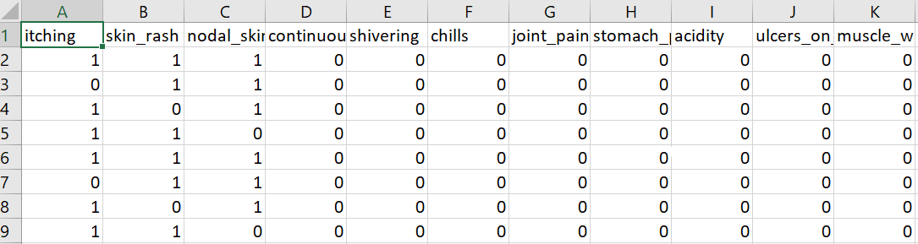
Datasets used
Structured data: This dataset is a manually created dataset and is structured for the usage in data analysis. This dataset is linear data.

Slide 8
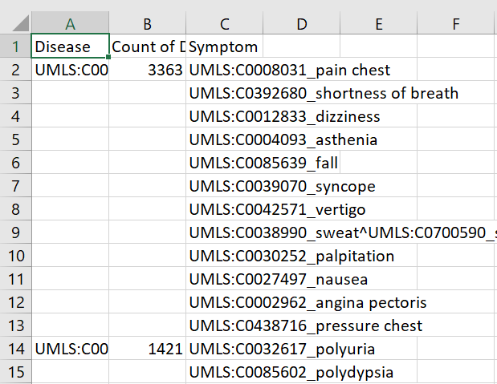
Datasets used
Unstructured data: This data is taken from a disease-symptom knowledge database obtained from automating responses from a hospital in 2004. It is in unstructured form i.e., not in the form that can be used for analysis and model building. So, data cleaning is performed on this dataset and converted into the form that may be useful for the model building.

Slide 9
Machine learning algorithms used

Slide 10
Decision Tree
Decision Tree algorithm belongs to the family of supervised learning algorithms. Unlike other supervised learning algorithms, the decision tree algorithm can be used for solving regression and classification problems too. The goal of using a Decision Tree is to create a training model that can use to predict the class or value of the target variable by learning simple decision rules inferred from prior data(training data). In Decision Trees, for predicting a class label for a record we start from the root of the tree. We compare the values of the root attribute with the record’s attribute. On the basis of comparison, we follow the branch corresponding to that value and jump to the next node. The decision of making strategic splits heavily affects a tree’s accuracy. The decision criteria are different for classification and regression trees. Decision trees use multiple algorithms to decide to split a node into two or more sub-nodes. The creation of sub-nodes increases the homogeneity of resultant sub-nodes. In other words, we can say that the purity of the node increases with respect to the target variable. The decision tree splits the nodes on all available variables and then selects the split which results in most homogeneous sub-nodes.

Slide 11
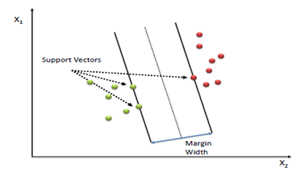
Support Vector Machine
A Support Vector Machine (SVM) is a discriminative classifier formally defined by a separating hyperplane. In other words, given labeled training data (supervised learning), the algorithm outputs an optimal hyperplane which categorizes new examples. In two dimensional space this hyperplane is a line dividing a plane in two parts where in each class lay in either side.

Slide 12
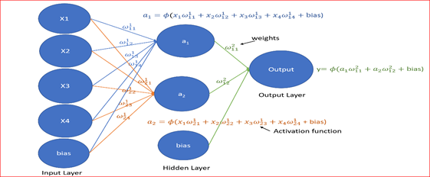
Artificial Neural network
A neural network receives input, converts the input signal by changing state using an activation function to produce an output
A neural network will have
• Input layer, with the bias unit which is 1. It is also referred as the intercept.
• One or more hidden layers, each hidden layer will have a bias unit
• Output layer
• Weights associated with each connection
• Activation function which converts an input signal of a node to an output signal
Input layer, hidden layer and output layers are usually referred as dense layers

Slide 13


Naive Bayes CLassifier
A Naive Bayes classifier is a probabilistic machine learning model that’s used for classification task. The crux of the classifier is based on the Bayes theorem.
Using Bayes theorem, we can find the probability of A happening, given that B has occurred. Here, B is the evidence and A is the hypothesis. The assumption made here is that the predictors/features are independent. That is presence of one particular feature does not affect the other. Hence it is called naive.
Suppose in a data set X is input matrix and Y is output matrix. Here x1,x2….xn represent the features. Y is a column matrix which contains two or more classes. So according to bayes theorem, Now, you can obtain the values for each by looking at the dataset and substitute them into the equation. For all entries in the dataset, the denominator does not change, it remain static. Therefore, the denominator can be removed and a proportionality can be introduced.

Slide 14
Random Forest
Random Forest is an extension over bagging. Each classifier in the ensemble is a decision tree classifier and is generated using a random selection of attributes at each node to determine the split. During classification, each tree votes and the most popular class is returned.
Implementation steps of Random Forest –
• Multiple subsets are created from the original data set, selecting observations with replacement.
• A subset of features is selected randomly and whichever feature gives the best split is used to split the node iteratively.
• The tree is grown to the largest.
• Repeat the above steps and prediction is given based on the aggregation of predictions from n number of trees

Slide 15
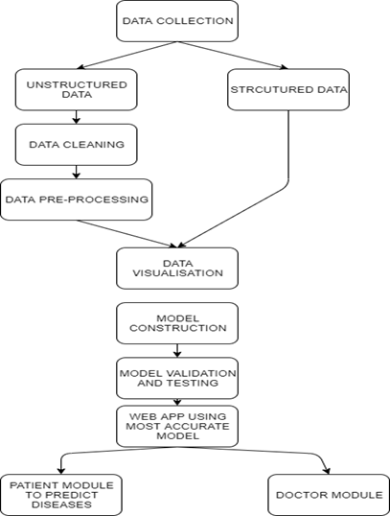
Proposed architecture

Slide 16
Project demonstration

Slide 17
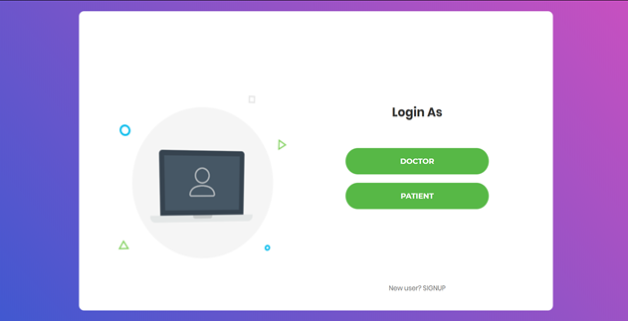

Slide 18
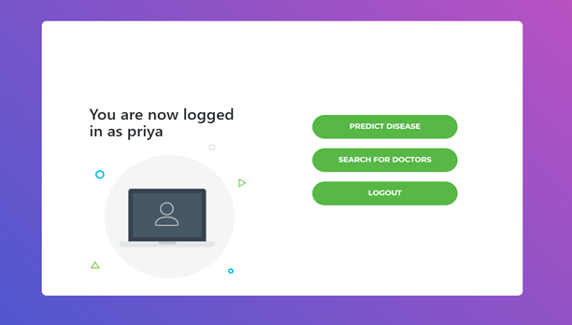

Slide 19
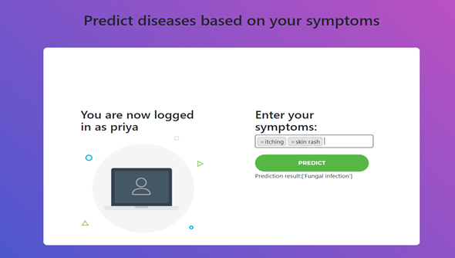

Slide 20
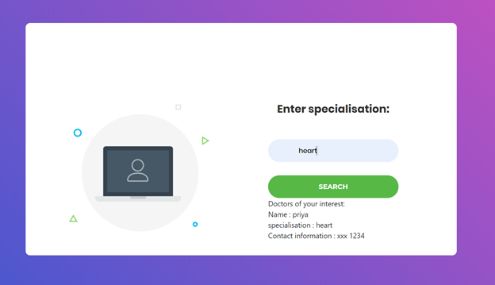

Slide 21
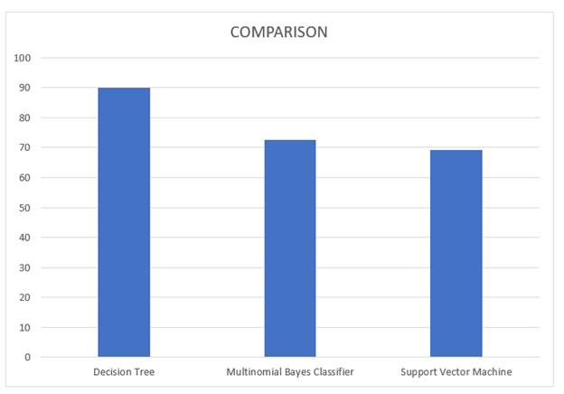
Comparison of algorithms used

Slide 22
Summary
In this project, a machine learning disease prediction system is proposed using structured and unstructured data from hospital for effective prediction of diseases. Existing work is not focused on both data types in the area of healthcare. Compared to the prediction algorithms used , the decision tree algorithm accuracy reaches 89.93%. A web application is also made based on the accurate model using flask for the patients to be able to predict the disease with most accuracy and doctors can also register for their increased exposure so that patients can search for them and contact them.

Slide 23
Thank you

